Slide 1
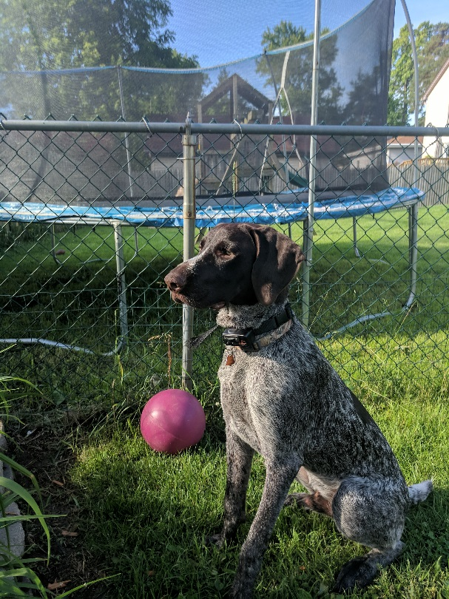
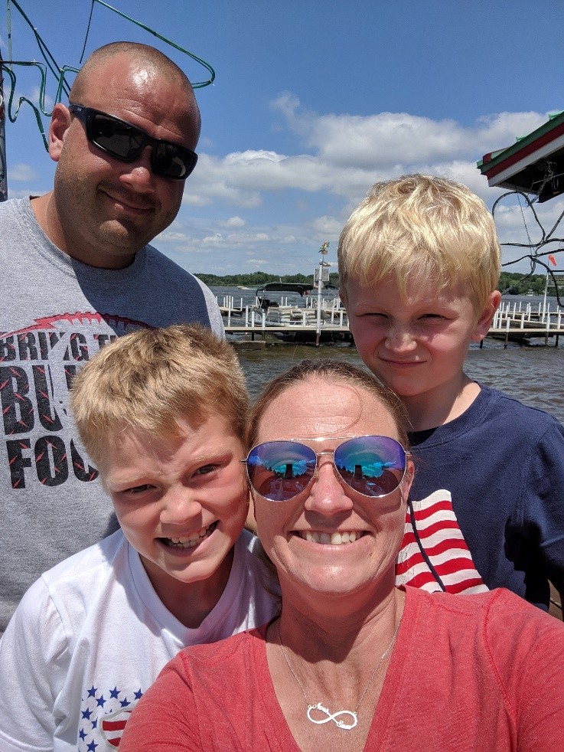
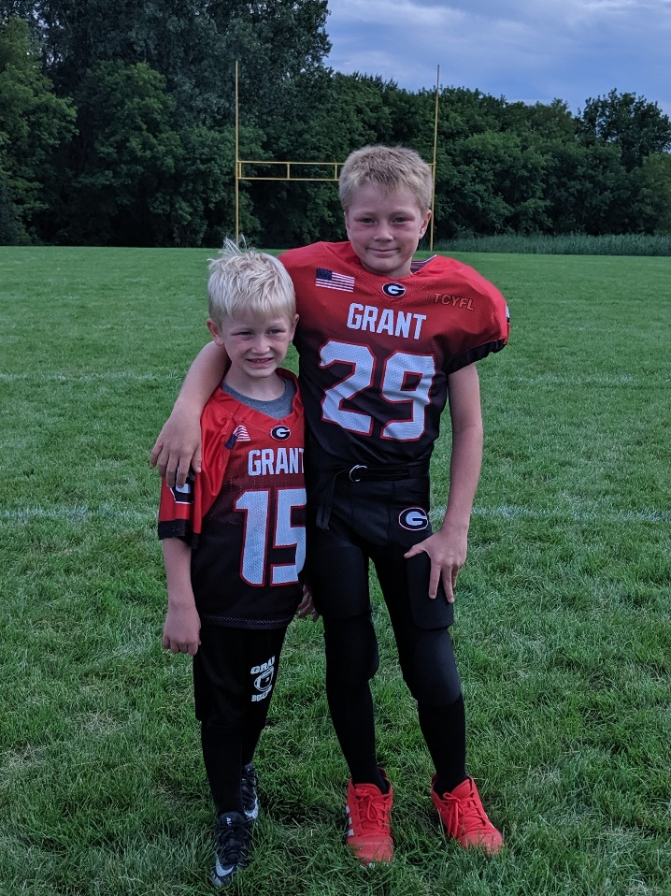
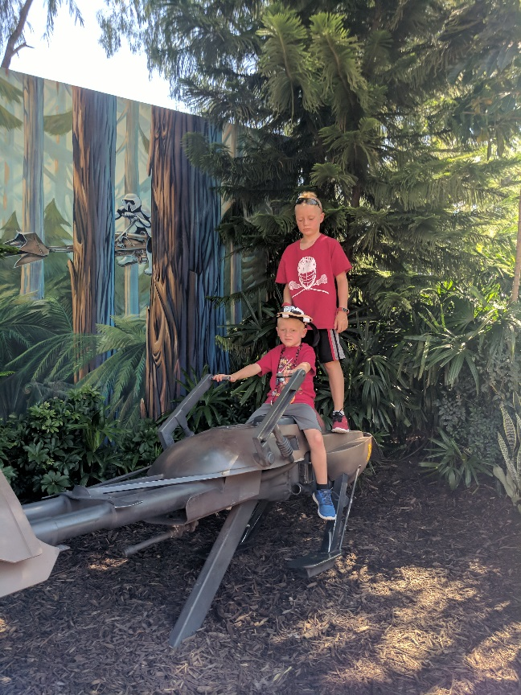

Slide 2
Daily Schedule 8:40-8:50 Announcements 8:50-9:00 Unpack and Calm Classroom 9:00-9:30 Math Interventions/ Second Step 9:30-9:45 Bathroom Break and Clam Classroom 9:45-10:50 Math 10:50-11:30 Recess/Lunch 11:30-11:40 Calm Classroom 11:40-12:10 ELA – Phonics 12:10-12:40 Specials 12:40-1:35 Reading Interventions and Reading Centers 1:35-2:00 P.E. 2:00-2:20 Snack and Reading Centers 2:20-2:50 ELA- Schoolwide 2:50-3:20 Science/Social Studies/Free Choice Time
Mon | Tues | Weds | Thurs | Fri
Music | Computer | Art | Computer | Library

Slide 3
Reading and Writing
Schoolwide
Schoolwide encourages balanced literacy through a reading workshop. Shared reading and independent practice are parts of the interactive read-alouds and mini-lessons. Each unit focuses on a different reading genre: Launching, Fiction, Non-fiction, and Poetry. Writing units include How writers work, Personal narrative, List and label, How-to, and FUNctional writing.
Open Court
Phonics skills and phonemic awareness skills
This includes learning the alphabet and letter sounds, blending sounds together, and learning sight words.

Slide 4
Eureka Math
Counting
Number writing
Analyzing 2-D and 3-D shapes
Comparison of length, weight and height
Addition and subtraction within 10
Counting to 100
* Math news will be sent home periodically to let you know what we will be covering and the vocabulary we are learning.

Slide 5
Behavior Management
STAR expectations will be taught, modeled, and retaught throughout the year. Students will be rewarded a Starbuck for following expectations. Please ask your child, “Did you earn any Starbucks today? What for?” This is the best way to find out how their day went. When I need to talk to a child about an expectation or do some individual/small group reteaching I will be sending home an expectation note to let you know what was retaught. If needed I will also call home to discuss behavior with you personally.

Slide 6
Reminders
Daily Folders- Please send them back and forth to school each day. Empty folders and keep work at home.
Lunch Money- Put money in daily folder or add it to your account on skyward.
Call the office if you need your skyward information.
Attendance-Please call the office if your child is going to be absent.
Homework-Please read every night and practice sight words. Record minutes read at home on the calendars in the front of the Agenda to meet the monthly goal.
Class Parties- We will have 3 class parties. Everyone is welcome to come. We ask that you send in $10 by Sept. 14th. More information will be sent out as parties get closer. I will need volunteers to plan the activities for the party, please let me know if you can help!

Slide 7
Agendas
District has provided agendas. They are a wonderful way for us to communicate.
Hot lunch
Pick up notes
Behavior notes

Slide 8
Conferences
Parent teacher conferences are Thursday, November 14 11:00p.m.-7:00p.m. Please sign up for a time. I will send a reminder note closer to conferences.

